Slide 1

Front-End And Back-End Communication
Data Transfer Patterns Between Server And Client
SoftUni Team
Technical Trainers
Software University
https://softuni.bg

Slide 2
Table of Contents
Direct Client-Server Communication
Server-Side Rendering
The API Gateway
Real-Time Communication

Slide 3
Questions
sli.do #microservices

Slide 4

Direct Client-Server Communication

Slide 5
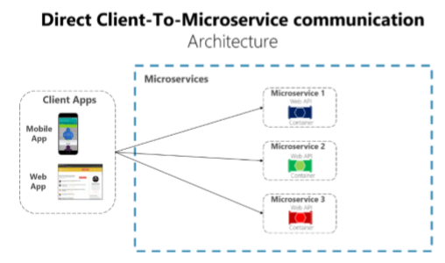
Direct Client-Server Communication
Used when different parts of a client’s page requests different microservices

Slide 6
Direct Client-Server Communication
Usually the client calls a load balancer, which requests data from the internal microservice infrastructure
Should be used when
The application is not huge
The data is independent and does not need additional aggregation
Otherwise the client needs to process business logic
Breaking separation of concerns

Slide 7
Direct Client-Server Communication
Drawbacks
Two many Internet round-trips outside of the internal microservice network
Microservices must be exposed to the “external world”
Cross-cutting concerns like authentication and authorization
Using synchronous communication like HTTP
Different client applications require different APIs
Consider web versus mobile clients

Slide 8
Server-Side Rendering

Slide 9
Server-Side Rendering
When the client application is not a JavaScript SPA
You can use REST (with Refit) or gRPC
You need to transfer the JWT to a cookie-based authentication
In the production environment, the other microservices can be hidden from the external world

Slide 10
The API Gateway

Slide 11
The API Gateway
Provides single-entry endpoint for a group of microservices
Like the Façade design pattern
Also knows as “backend for frontend”
You build it for the specific client needs
Acts as a reverse proxy and man in the middle between the clients and the microservices
Can also provide authentication, cache, and other cross-cutting concerns

Slide 12
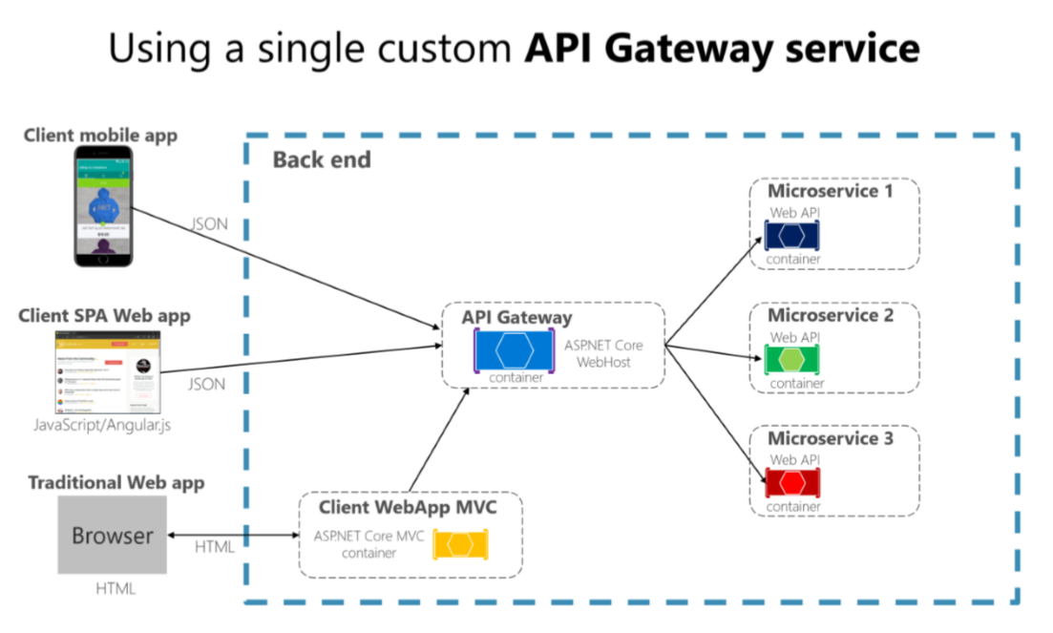
The API Gateway

Slide 13
The API Gateway
If you are not careful, the API gateway may become a full monolithic app
Bloated with too many endpoints
Couples all microservices, destroying their benefits
API Gateways should also be segregated
At first it may be an API Gateway for each client
But then it may be further split by logical groups based on business boundaries
HTTP or gRPC

Slide 14
The API Gateway
Reverse proxy and routing
Decouples the client
Modernize legacy monolithic app
Hide the internal microservices
Request aggregation
Reduces chattiness between client and microservices
Especially important for remote applications
Offloading
Authentication, load balancing, retry policies, response caching, IP whitelisting, and more

Slide 15
The API Gateway
Coupling with the internal microservices
Additional point of failure
Additional network calls
Usually does not have a huge impact considering the alternative
May become a bottleneck
Additional development costs and maintenance

Slide 16
The API Gateway
API Gateway implementations
Using Ocelot
https://github.com/ThreeMammals/Ocelot
For proxy and rerouting
Hiding internal services
Using custom implementation
More flexibility with data aggregation

Slide 17
Real-Time Communication

Slide 18
Real-Time Communication
Real-time communication can be achieved with HTTP Web Sockets
With fallback mechanisms
It is used when you want to push data to the clients directly
ASP.NET Core has SignalR as a real-time communication technology

Slide 19
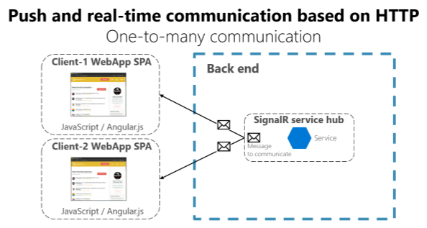
Real-Time Communication

Slide 20

Summary
…
…
…
Direct Client-Server Communication
Server-Side Rendering
The API Gateway
Real-Time Communication

Slide 21
Questions?
Notes:
21

Slide 22
Trainings @ Software University (SoftUni)
Software University – High-Quality Education, Profession and Job for Software Developers
softuni.bg, softuni.org
Software University Foundation
softuni.foundation
Software University @ Facebook
facebook.com/SoftwareUniversity
Software University Forums
forum.softuni.bg
Notes:
22

Slide 23

License
This course (slides, examples, demos, exercises, homework, documents, videos and other assets) is copyrighted content
Unauthorized copy, reproduction or use is illegal
© SoftUni – https://softuni.org
© Software University – https://softuni.bg
Notes:
23

